Slide 1
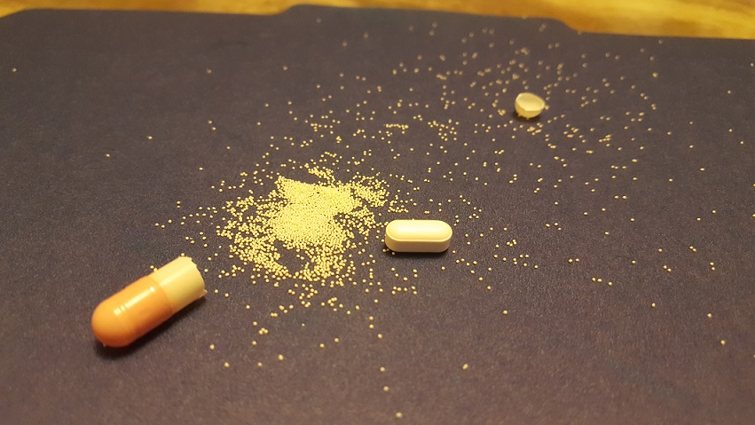
PROJECT BATCH – 5B
REVIEW - 1
MUKHEE JYOTHSNA
KORNU ASHOK KUMAR
3. PATHIVADA SAI JAHNAVI
4. SALLANGI NIKHILA
PROJECT SUPERVISOR
Dr. P . Srinivasa Rao
Associate Professor

Slide 2
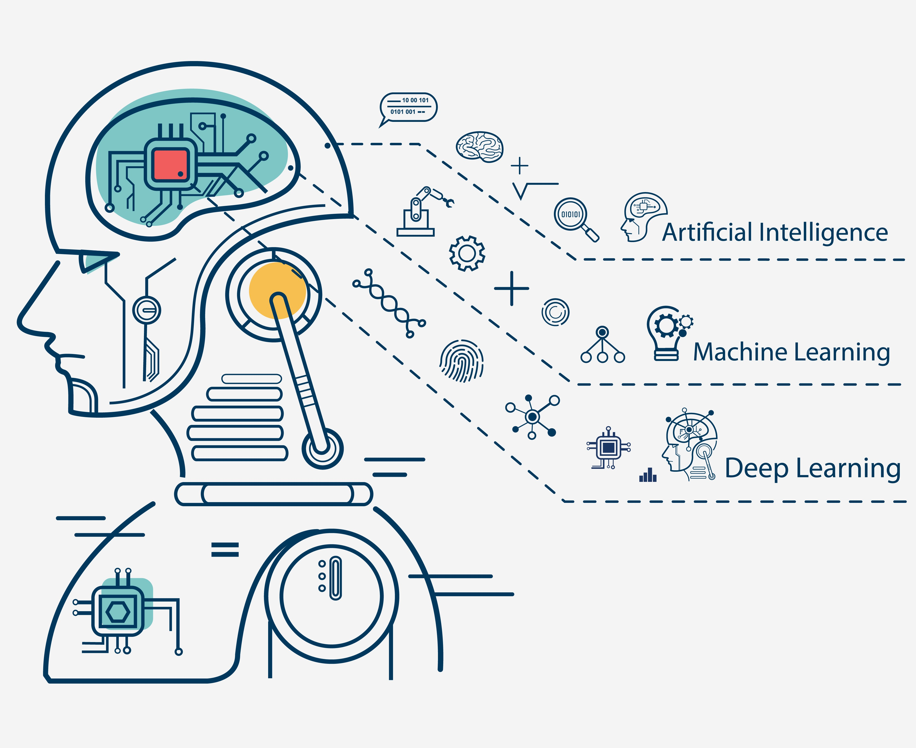

DRUG DISCOVERY (COMPOUND SIMILARITY PREDICTION)
Project Area : Machine Learning
Notes:
Jay

Slide 3
objective: To incorporate machine learning techniques that help expedite the process of drug discovery and development which consumes less expenditure and process time. Ciprofloxacin is an antibiotic used to treat a number of bacterial infections. The lead compound of ciprofloxacin is piperazine and on further synthesis of piperazine it will give 38 different drugs. So, the main objective of project is to cluster the compounds according to their similarity. After clustering is done, we could able to predict the reaction of the unknown compound. proposed method: In the proposed system, clustering algorithms will be applied to group similar compounds that have a similar chemical, biological and physical characteristics of lead compounds in drug discovery. With this, computer can estimate the amount of drug required to sent to person. (IMPLEMENTED).

Slide 4
ABSTRACT
Drug designers mine chemical data from large databases to extract chemical compounds that becomes the lead compounds in drug discovery. The drug target designing combine machine learning and deep learning algorithm that improve the quality of drugs discovered. Both supervised and unsupervised algorithm when applied to the databases increases the efficacy of identifying a new target and optimize the lead compound. Drug discovery process involves seven step process
that includes disease selection, target hypothesis, lead identification, lead optimization, pre-clinical trial, clinical trial, pharmacogenic identification. machine learning can be applied to identify the drug targets and in optimization of lead compound. The process failure rate when machine learning is applied will be very low compared to the traditional drug discovery process. The project mainly works on fingerprint generation and finding similarity coefficients. Some of the clustering algorithms are k-means, agglomerative hierarchical, fuzzy c-means. Through this compound similarity prediction, the compounds are clustered according to their similarity. So, if the reaction of a new compound is unknown, we can know its reaction through this compound similarity prediction. The primary benefit of compound similarity prediction is that it allows one to predict the reaction of a new compound. We can speed up the drug discovery process if we know how a novel molecule reacts.

Slide 5

Research problem: To identify the similar compounds among huge databases based on the chemical and biological properties and estimate the amount of drug we need to give to a person with certain conditions.

Slide 6
Literature Survey
[1] Hakime Ozturk, Arzucan Ozgur Described In “Exploring chemical space using Natural Language Processing Methodologies for Drug Discovery ”, as to take the Information about the design and discovery of drugs with the column called SMILES. SMILES(Simplified Molecular Input Entry Specification) consists of all the chemical formula of each and every compound. From this paper I invoked the purpose of extracting the similar compounds from SMILES and the procedure of extracting the SMILES.
[2] Hakime Oztruk, Arzun Ozgur Described, In “A comparative study of SMILES-based Compund similarity functions for drug-target interaction prediction ”, I Refered in depth of SMILES and I conclude that the more efficient SMILES based similarity functions performed similarly to the more complex 2D- based SIMCOMP Kernal.
We can identify the interactions data sets clearly using fingerprints.
[3] Vogt M and Bajorath J Described in “ccbmlib – a Python package for modelling Tanimoto similarity value distributions”. It described the information about how to use the ccbmlib Python package which is a collection of modules for modelling similarity value distributions. From this paper i invoked that this is used to assess the statistical significance of tanimoto coefficients and evaluate how molecular similarity is reflected when different fingerprint representations are used and conditional significance score to estimate where a test compound would be ranked in a search and the resulting models have been evaluated for RDKit fingerprints, taking a collection of ChEMBL compounds as a reference data set. I conclude that the Highly accurate models were obtained, with difference of 1% or less for indicating high similarity

Slide 7
[4] B. Zagidullin, Z. Wang, Y. Guan, E. Pitkänen and J. Tang Described in “Comparative analysis of molecular fingerprints in prediction of drug combination effects”. From this documentation it describes that to compare rule-based and data-driven molecular representations in prediction of drug combination sensitivity and finding drug synergy scores using standardized results and later on to evaluate the clustering performance of molecular representations and quantify their similarity by adapting the Centred Kernel Alignment metric (identify an optimal molecular representation type (CKA)). The included Data-driven fingerprints, namely VAE 256 bits long trained on SMILES and Infomax 300 bits long-trained molecular graphs are well-suited for regression tasks. 1024 bits long 2D and 3D circular fingerprints are flexible and well-performant rule-based models fit for clustering tasks
[5] Alice Capecchi, Daniel Probst and Jean‑Louis Reymond described in “One molecular fingerprint to rule them all: drugs, biomolecules, and the metabolome”. The documentation described that MAP4 is a new molecular fingerprint suitable for drugs and can be adopted as a universal fingerprint to describe and search chemical space so here it takes MinHasing. MinHasing is used for MAP4 allows the construction of k-NN trees and the creation of high-resolution chemical space tree-maps (TMAPs) for databased as diverse as DrugBank
[6] Ravi Manne Described in “Machine Learning Techniques in Drug Discovery and Development”, I examined machine learning and deep learning techniques which help pharma industry in all stages of drug discovery which includes target validation, prognostic bookmarks, technical traits, in which these are totally seven phases in the process of drug discovery.

Slide 8
[7] Suresh Dara, Surender Singh Jadav, Swetha Dhamercherla, CH Madhu Babu, Mohamed Jawed Ahsan Described in “Machine Learning in Drug Discovery” the feasible literature on drug discovery through ML tools and techniques that are enforced in every phase of drug development to accelerate the research process. Target validation, prognostic biomarkers, digital pathology are considered as the problem statements where In clinical trials, absolute and methodological data must be generated to tackle many puzzles in validating ML techniques, improving decision-making, promoting awareness in ML approaches, and deducing risk failures in drug discovery.
[8] I used “Anaconda and Jupyter Note Setup” to install anaconda for my execution where,the Anaconda distribution includes the Conda package manager in addition to the preconfigured Python packages and other tools. Anaconda Navigator is a GUI tool that is included in the Anaconda distribution and makes it easy to configure, install, and launch tools such as Jupyter Notebook.

Slide 9
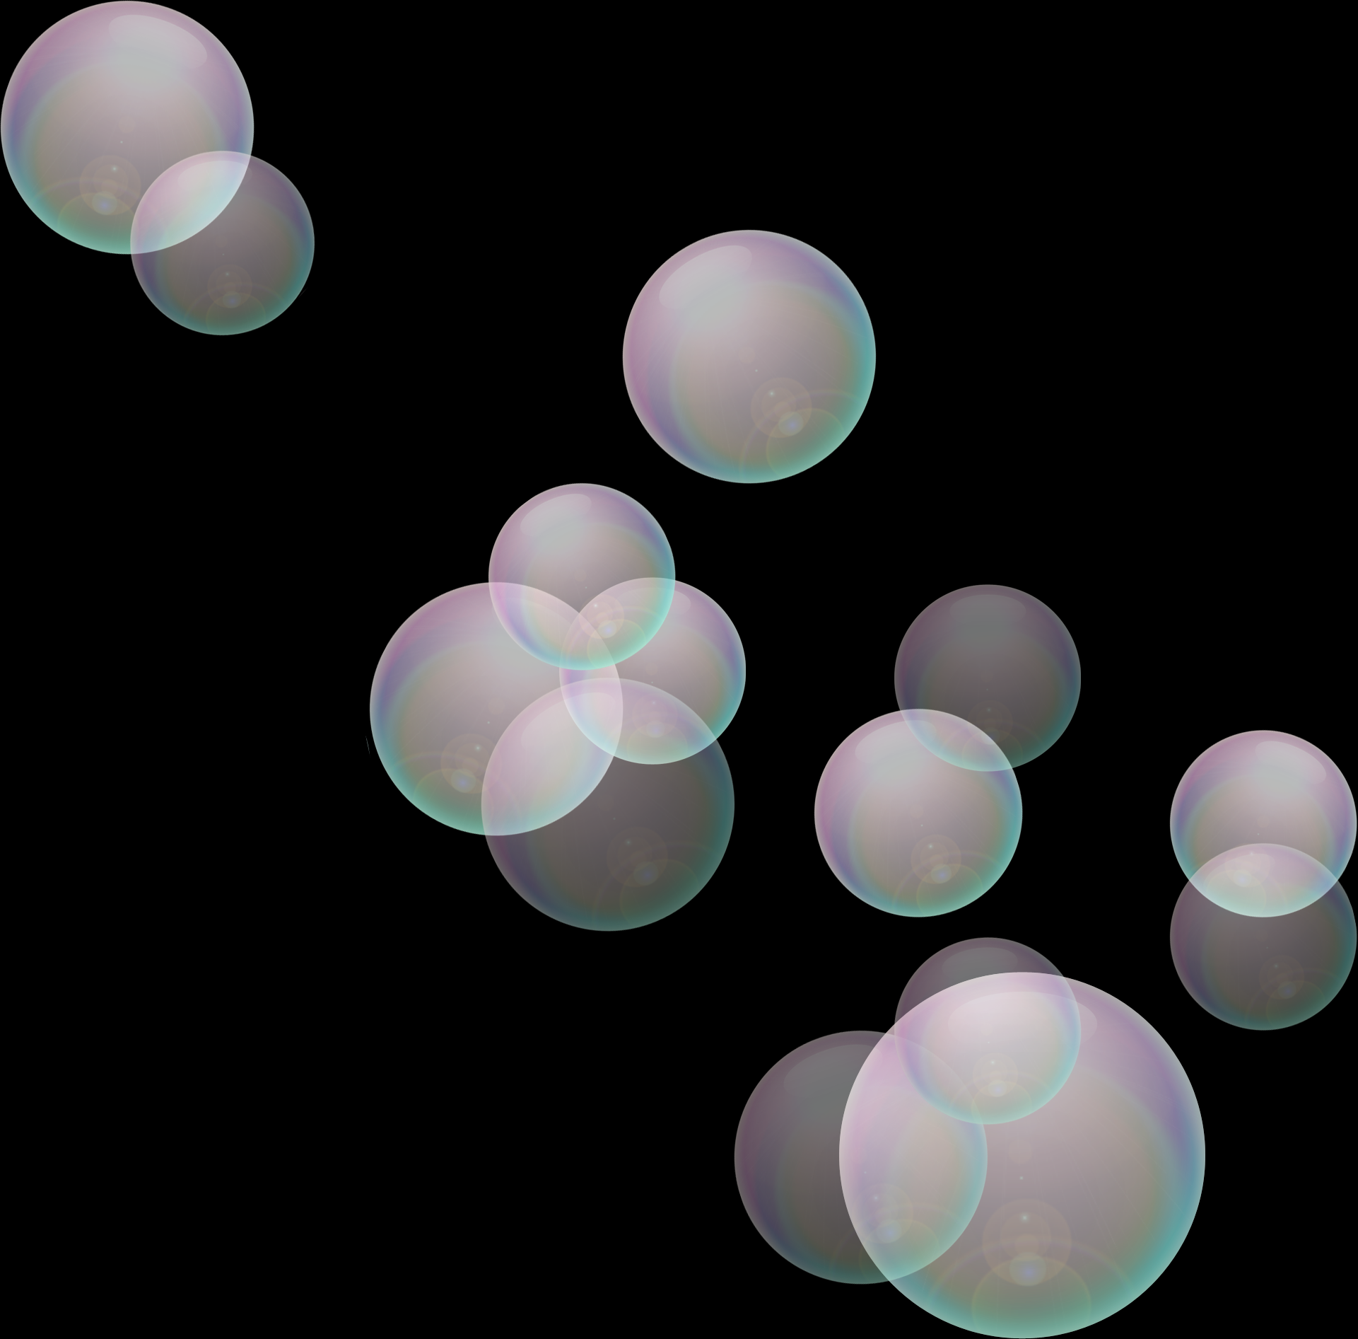
INPUTS REQUIRED FOR THE PROJECT:
DATA SET OF THE ANTIBIOTIC WHICH CONTAINS THE DATA FIELDS OF STRUCTURE, DRUG CONTANT ETC.
CONDITIONS OF PATIENT:
1. REACENTLY EFFECTED TO COVID?
2. REACENTLY MET WITH AN ACCIDENT?
3. SUFFERING FROM COLD?
4. SUFFERING FROM COUGH?
5. SUFFERING FROM FEVER?
OUTPUT :
WE CAN ANALYSE THE SIMILAR COMPOUNDS AND CAN ESTIMATE THE AMOUNT OF DOSE REQUIRED BY THE PATIENT.

Slide 10
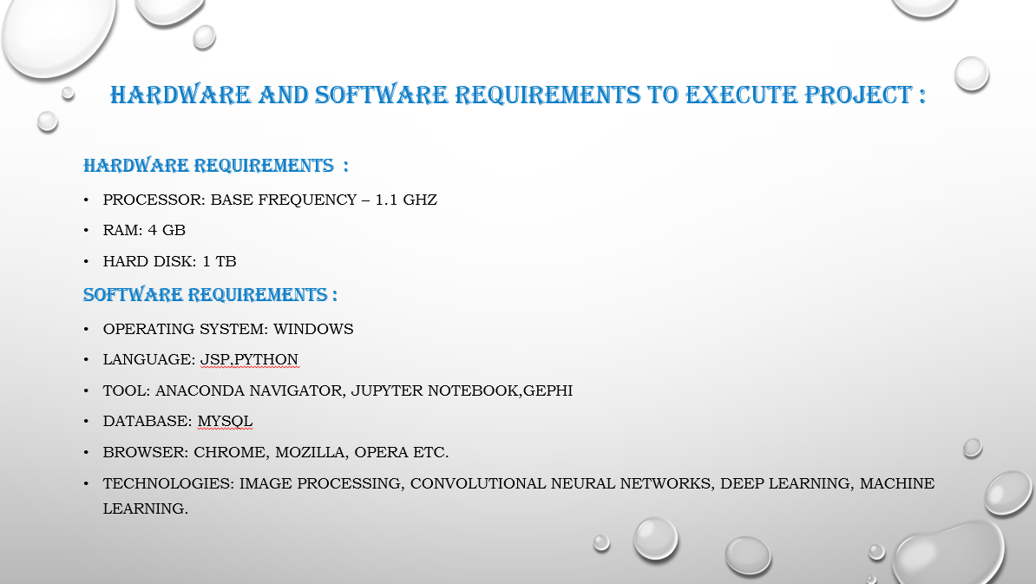

Slide 11
DURATION
S.NO | STAGES | DURATION
1. | Requirements Gathering and Literature Survey | 2 WEEKS
2. | High-level and detailed design | 2 WEEKS
3. | Coding | 14 WEEKS
4. | Result Analysis | 2 WEEKS
5. | Documentation | 2 WEEKS

Slide 12
Algorithms Used:
1. K- Means Clustering.
Libraries used:
1.Numpy
2.Pandas
3.Matplotlib
4.Sklearn
5.Rdkit
6.Seaborn

Slide 13
K-Means:
K-Means is a clustering algorithm in machine learning that can group an unlabeled dataset very quickly and efficiently in just a few iterations. It works by labelling all instances on the cluster with the closest centroid. When the instances are centerd around a particular point, that point is called a centroid.
The computational complexity of the K-Means clustering algorithm is generally linear concerning:
the number of instances m,
the number of clusters k,
and the number of dimensions n.
This is only true when the dataset has a clustering structure if the dataset has no clustering structure, the worst-case time complexity of the algorithm may increase exponentially with the number of instances. In real-time issues, this never happens and K-means clustering is considered to be one of the fastest clustering algorithms.

Slide 14
References
[1]. Hakime Ozt¨urk ¨ a , Arzucan Ozg¨ur ¨ a , Philippe Schwaller b , Teodoro Lainob, ∗ , Elif Ozkirimlic,d, “Exploring Chemical Space using Natural Language Processing Methodologies for Drug Discovery.”,arXiv peprint 2020.
[2]. Hakime Öztürk* , Elif Ozkirimli* and Arzucan Özgür*
“ A comparative study of SMILES-based compound similarity functions for drug-target interaction prediction.” arXiv peprint 2020.
[3]. Martin Vogt , Jürgen Bajorath Department of Life Science Informatics, B-IT, University of Bonn, Endenicher Allee
ccbmlib – ” a Python package for modeling Tanimoto similarity value distributions [version 1; peer review: 2 approved] “ , 19c, Bonn, NRW, 53115, Germany,
[4]. B. Zagidullin, Z. Wang, Y. Guan, E. Pitkänen and J. Tang
“ Comparative analysis of molecular fingerprints in prediction of drug combination effects.“,brefings in bioinformatics,22(6),2021
[5]. Daniel Probst and Jean‑Louis Reymond
“ One molecular fngerprint to rule them all: drugs, biomolecules, and the metabolome Alice Capecchi.”, jouneral of cheminformatics,2020

Slide 15
[6]. Ravi Manne, ” Machine Learning Techniques in Drug Discovery and Development “,all research, 2021
[7]. Suresh Dara1 · Swetha Dhamercherla1 · Surender Singh Jadav2 · CH Madhu Babu1 · Mohamed Jawed Ahsan3 , “Machine Learning in Drug Discovery: A Review”, springer Nature B.V. 2021
[8]. Geeks for geeks and tutorial point, Anaconda navigator installation jupyter notebook environment setup
[9]. John B. O. Mitchell∗ “Machine learning methods in chemoinformatics”, WIREs Comput Mol Sci 2014
[10]. N. Priya1 and G. Shobana2 “Application of Machine Learning Models in Drug Discovery: A Review”, Research Trend , 2019
[11]. Dataset link: https://drugcentral.org/download

Slide 16
CONCLUSION
Drug discovery is a long process and takes years to discover a new drug. So in order to reduce time we need machine learning algorithms to speed up the process of drug discovery. We also find many drugs but we don’t know the reaction of each drug. If we know the reaction of drug then we could save some time in discovering new medicine.so we have done compound similarity prediction and until now we have read many papers regarding classification, supervised and unsupervised clustering techniques and many algorithms. We used k-means clustering for compound similarity prediction and also, we used density-based clustering algorithm. Finally, we clustered the compounds based on their similarity. We have successfully implemented compound similarity prediction and finally we can know the reaction of the new drug.

Slide 17


